Slide 1
Lesson 12: Protecting a network
Mack 2023
Notes:
Last updated 30-11-2021
Resources are updated regularly — the latest version is available at: ncce.io/tcc.
This resource is licensed under the Open Government Licence, version 3. For more information on this licence, see ncce.io/ogl.

Slide 2

Data at school
Starter activity
Question
What data about students and staff is stored by the school?
Explorer task
Why is it important to ensure that this data is kept safe?
Notes:
Image source: https://pixabay.com/photos/cyber-security-online-computer-2296269/

Slide 3
What data about students and staff is stored by the school?
Starter activity
Mobile phone numbers
Parents / Carers details
Timetable
Names and addresses
Medical needs
Staff bank account information (for salaries)
Siblings
Emergency contacts

Slide 4
Why is it important to ensure that this data is kept safe?
Starter activity
To protect people from:
Fraud
Phishing scams
Identity theft
To avoid the loss of sensitive data
Failure to do so could result in the school breaking the laws of the data protection act
Notes:
Image source: https://pixabay.com/photos/cyber-security-online-computer-2296269/

Slide 5

Lesson 12: Protecting a network
Objectives
In this lesson, you will:
Determine the need for and importance of network security
Identify different forms of attacks on networks (social engineering, malicious software)
Explain network security methods

Slide 6

Forms of attack
Activity 1
Networks are extremely vulnerable to attack. This is because they can:
Span large geographical areas
Have large numbers of users
Be expensive to maintain and keep up to date with the latest security threats
It is important for network engineers to protect the network from attack.
Notes:
Image source: https://pixabay.com/photos/computer-security-padlock-hacker-1591018/

Slide 7
Forms of attack
Activity 1
There are two main forms of attack that can happen to a network. These are:
Social engineering
Malicious software
Notes:
Image source: https://pixabay.com/photos/computer-security-padlock-hacker-1591018/

Slide 8
Social engineering
Activity 1
Social engineering is where an attacker tries to manipulate an individual into revealing confidential information.
Some examples of social engineering are:
Phishing
Blagging
Shouldering
Notes:
Image source: https://pixabay.com/photos/computer-security-padlock-hacker-1591018/

Slide 9
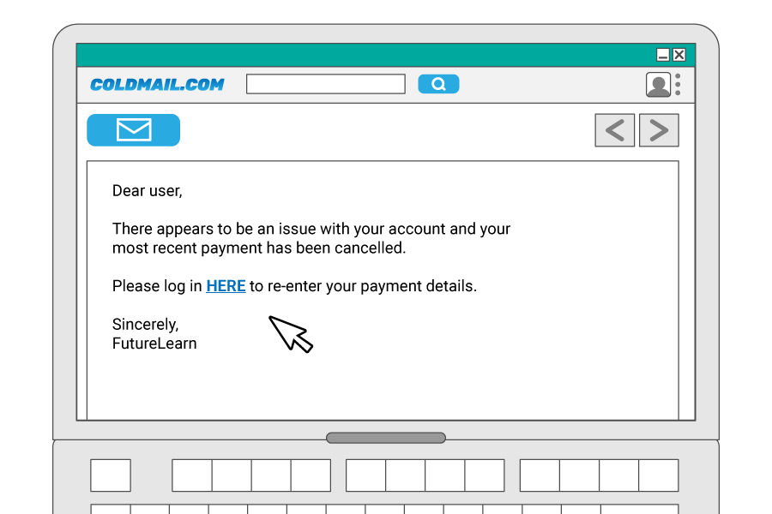
Social engineering
Activity 1
Phishing is when an attacker sends fraudulent emails to large groups of people in an attempt to get them to click a link to a site that encourages them to enter their personal details.
Notes:
Image source: Raspberry Pi Foundation

Slide 10
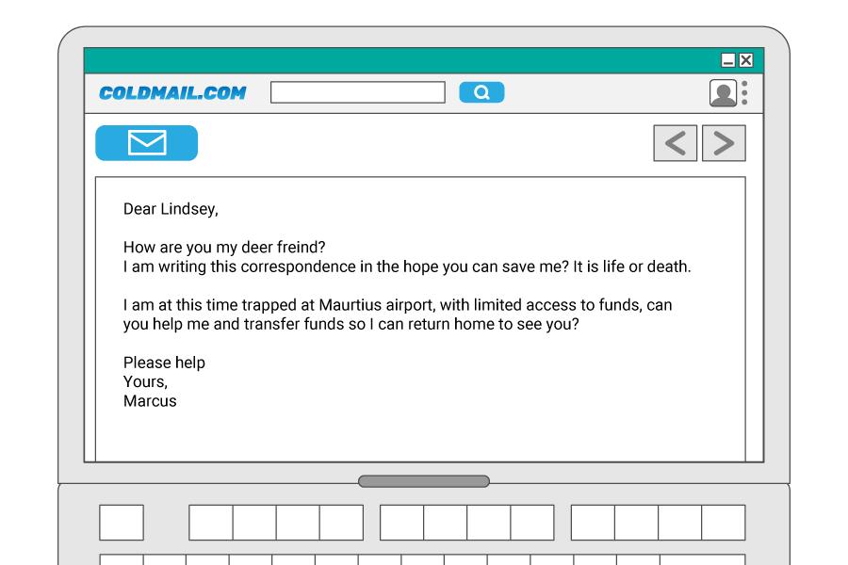
Social engineering
Activity 1
Blagging is when an attacker invents a scenario in order to convince the victim to give them data or money.
What makes this different to a phishing attack is that this attack often requires the attacker to maintain a conversation with the victim until they are persuaded to give up whatever the attacker has asked for.
Notes:
Image source: Raspberry Pi Foundation

Slide 11
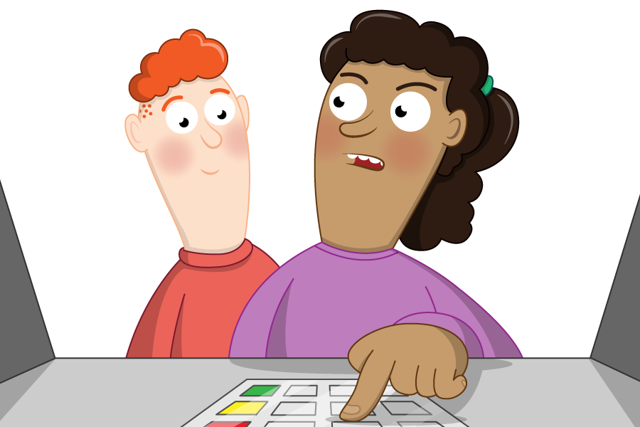
Social engineering
Activity 1
Shouldering is an attack designed to steal a victim's password, or other sensitive data.
It involves the attacker watching the victim provide sensitive information.
This type of attack might be familiar as it is often used to find out someone's PIN at a cash machine.
Notes:
Image source: Raspberry Pi Foundation

Slide 12
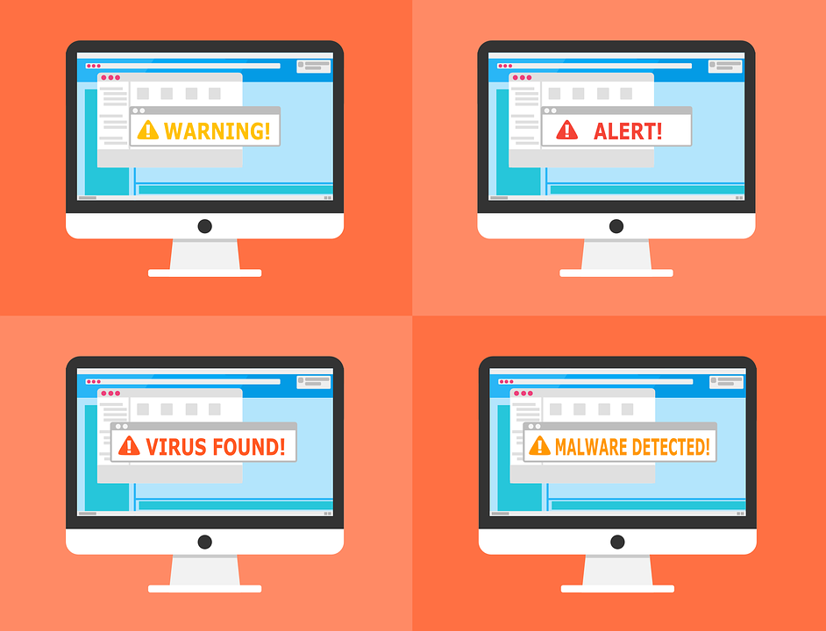
Malicious software
Activity 1
Malicious software (malware) is software that is designed to cause harm to a network.
Types of attack include:
Distributed denial of service attacks (DDoS)
Pharming
Viruses
Trojans
Notes:
Image source: https://pixabay.com/vectors/warning-alert-detected-malware-2168379/

Slide 13


Malicious software
Activity 1
503 error Service Unavailable
A distributed denial of service attack (DDoS) is when a server gets flooded with traffic in order to overwhelm it and disrupt the service.
This can cause the website to load more slowly or even stop it being accessed at all.

Slide 14
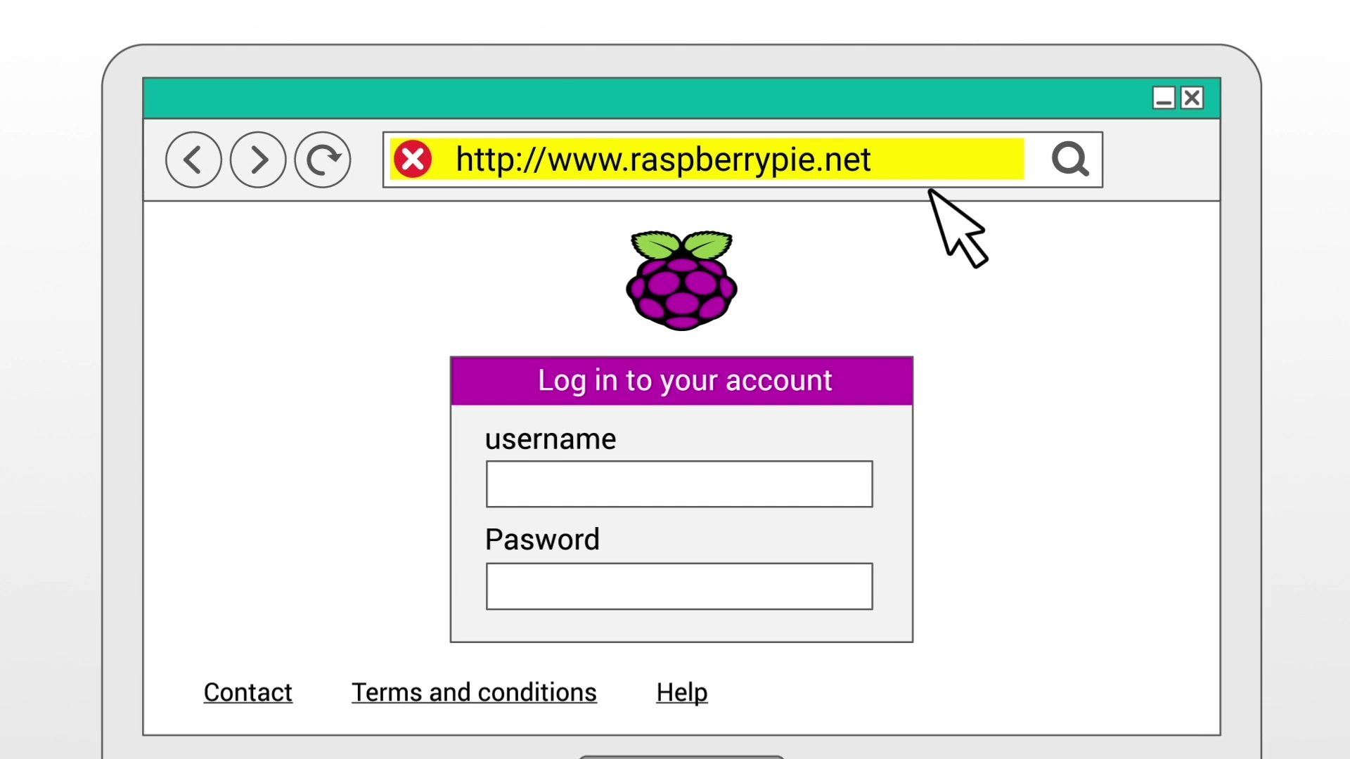
Malicious software
Activity 1
A pharming attack is when malware redirects the victim to a malicious version of a website.
The malware could infect the victim's computer or the DNS server.
When the victim enters a web address into their browser, the compromised DNS directs the user to a website controlled by the attacker.
Notes:
Image source: Raspberry Pi Foundation

Slide 15
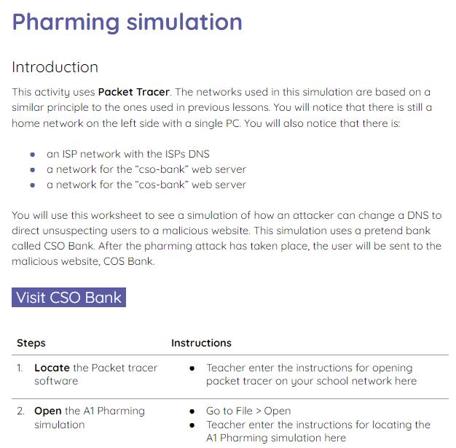
Pharming simulation in Packet Tracer
Activity 1
Use the activity 1 sheet to see a simulation of pharming in Packet Tracer.

Slide 16
Security threats
Activity 2
Any device that is connected to a network is vulnerable to some form of attack.
This is why it is important to know what the threats are and how to protect a network from those threats.
Notes:
Image source: https://pixabay.com/photos/cyber-security-online-computer-2296269/

Slide 17

Security threats
Activity 2
One of the main vulnerabilities of a network is the users of that network.
Why do you think this is?
Discuss in pairs and be prepared to share your response with the class.
Notes:
Image source: https://pixabay.com/photos/cyber-security-online-computer-2296269/

Slide 18
Security threats
Activity 2
It is important that users are trained to identify potential signs of attack. For example:
Emails that ask for login or personal details or to click on a link
Telephone calls from ‘technicians’ asking for passwords
Unauthorised visitors entering the building
Notes:
Image source: https://pixabay.com/photos/cyber-security-online-computer-2296269/

Slide 19
User access rights
Activity 2
As well as training users, network administrators can give users different levels of access to the network.
Users should only have the level of access that they need to perform their role.
Notes:
Image source: https://pixabay.com/photos/cyber-security-online-computer-2296269/

Slide 20
User access rights (think, write, pair, share)
Activity 2
List the types of users that a school could have (e.g. teachers, students)
Decide what each type of user should be allowed to do on the school network (e.g. install software, view financial details)

Slide 21
User access rights (think, write, pair, share)
Activity 2
List the types of users that a school could have (e.g. teachers, students)
Support staff (caretakers, catering, cleaners)
Students
Teachers
Teaching assistants
Secretary
Finance administration
School governors
Network administrators

Slide 22
User access rights (think, write, pair, share)
Activity 2
User
Teachers and teaching assistants
Network privileges
Read access to shared area
Write access to shared area
Read/write access to personal area
Access to student information
Access to financial information
Can install software
Can set up new users
Personal email & internet access
Ability to print

Slide 23
User access rights (think, write, pair, share)
Activity 2
User
Network administrator
Network privileges
Read access to shared area
Write access to shared area
Read/write access to personal area
Access to student information
Access to financial information
Can install software
Can set up new users
Personal email & internet access
Ability to print

Slide 24
User access rights (think, write, pair, share)
Activity 2
User
Finance administrator
Network privileges
Read access to shared area
Write access to shared area
Read/write access to personal area
Access to student information
Access to financial information
Can install software
Can set up new users
Personal email & internet access
Ability to print

Slide 25
User access rights (think, write, pair, share)
Activity 2
User
Students
Network privileges
Read access to shared area
Write access to shared area
Read/write access to personal area
Access to student information
Access to financial information
Can install software
Can set up new users
Personal email & internet access
Ability to print

Slide 26
User access rights (think, write, pair, share)
Activity 2
User
Support staff and school governors
Network privileges
Read access to shared area
Write access to shared area
Read/write access to personal area
Access to student information
Access to financial information
Can install software
Can set up new users
Personal email & internet access
Ability to print

Slide 27
User access rights
Activity 2
Having different levels of privileges on a network means that:
If individual accounts are compromised, the potential damage is limited
Users have less chance of introducing malware to the network if they can’t install software
There is less chance users will accidentally or deliberately tamper with or steal data they shouldn’t be able to see
Notes:
Image source: https://pixabay.com/photos/cyber-security-online-computer-2296269/

Slide 28
Other methods for protecting a network
Activity 2
There are many other ways to protect a network. These include:
Anti-malware software
Firewalls
Penetration testing
Physical security
Backup and recovery
Staff training
You will learn more about these in the next activity.
Notes:
Image source: https://pixabay.com/photos/cyber-security-online-computer-2296269/

Slide 29

Game: defend the net
Activity 3
In groups you will now compete against your classmates to stop the threats to the network from getting through.
The group that protects the network the fastest is the winner!
Notes:
Image source: https://pixabay.com/vectors/shield-escutcheon-heraldic-shield-31869/

Slide 30
The setup: defend the net
Activity 3
Each group is given a team character to play on the board.
Each character is placed at the start of the board.
Each group is given two defense cards from the defense card deck to start with.
The starting team is the team that rolls the lowest number on a dice. If teams roll the same (lowest) number then they roll again.
Notes:
Image source: https://pixabay.com/vectors/shield-escutcheon-heraldic-shield-31869/

Slide 31
How to play: defend the net
Activity 3
At the start of each play, the group takes a new defense card.
They then take an alert card and read it to the class.
The group looks at their defense cards to see if they can defend the net from this threat.
If the group cannot defend the net with any of their defense cards then they stay in position and the next group to the left takes their turn.
Notes:
Image source: https://pixabay.com/vectors/shield-escutcheon-heraldic-shield-31869/

Slide 32
How to play: defend the net
Activity 3
If they can defend the net with one of their defense cards then:
They read the contents of the defense card to the class
They play their defense card and place it on the bottom of the defense card deck
They move their character the number of places shown on the threat card
The next team to the left takes their turn
Notes:
Image source: https://pixabay.com/vectors/shield-escutcheon-heraldic-shield-31869/

Slide 33

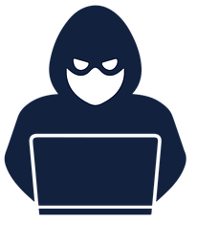






Defend the net
Activity 3
Finish
Start
Notes:
Image sources
Shield: https://pixabay.com/vectors/shield-escutcheon-heraldic-shield-31869/
Flag: https://pixabay.com/vectors/checkered-flag-finish-line-309862/
Virus: https://pixabay.com/vectors/coronavirus-line-art-virus-5019475/
Hacker: https://pixabay.com/vectors/hacker-anonymous-criminal-internet-6639626/
Player characters: Costumes used from the programming language, Scratch https://scratch.mit.edu/

Slide 34
Protect the network
Wrap Up
State one network security threat
Give at least one example of how a network can be protected from your stated threat
Be prepared to share your answer with the class.
Notes:
Image source: https://pixabay.com/photos/cyber-security-online-computer-2296269/

Slide 35
Next lesson
Summary
In this lesson, you…
Learnt about the different network security threats
Next lesson, you will…
Take the summative assessment for this unit of work

